Slide 1
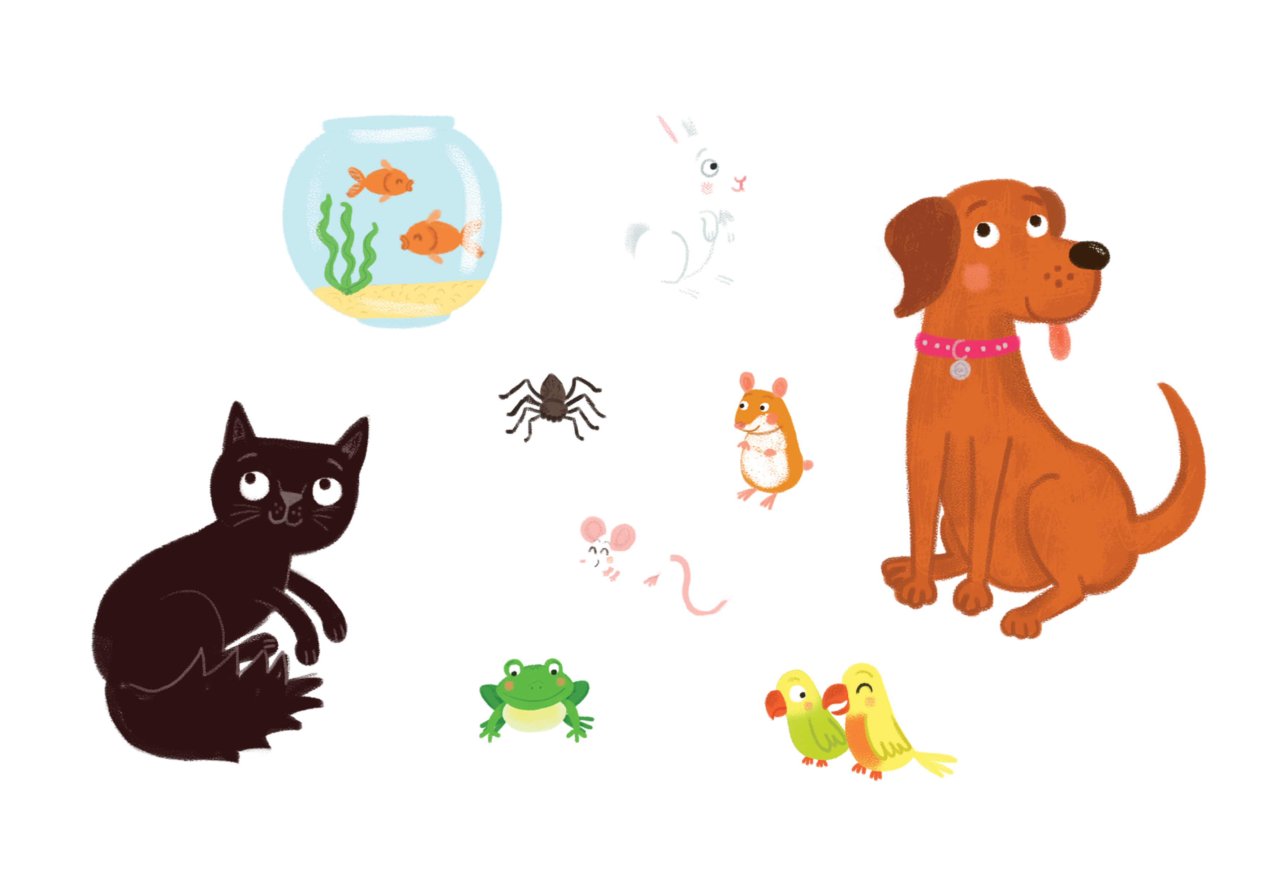

Suas is sìos
Suas is sìos
Aon, dhà, trì
Rabaid gheal, rabaid gheal
Leum, leum, uì !
Notes:
Up and down
Up and down
One, two, three
A white rabbit, a white rabbit
Jump, jump, weeeeeee!

Slide 2
Suas is sìos
Suas is sìos
Aon, dhà, trì
Losgann uaine, losgann uaine
Leum, leum, uì !
Notes:
Up and down
Up and down
One, two, three
A green frog, a green frog
Jump, jump, weeeeeee!

Slide 3
Suas is sìos
Suas is sìos
Aon, dhà, trì
Muncaidh donn, muncaidh donn
Leum, leum, uì !
Notes:
Up and down
Up and down
One, two, three
A brown monkey, a brown monkey
Jump, jump, weeeeeee!

Slide 4

Suas is sìos
Suas is sìos
Aon, dhà, trì
Each beag dubh, each beag dubh
Leum, leum, uì !
Notes:
Up and down
Up and down
One, two, three
A little black horse, a little black horse
Jump, jump, weeeeeee!

Slide 5
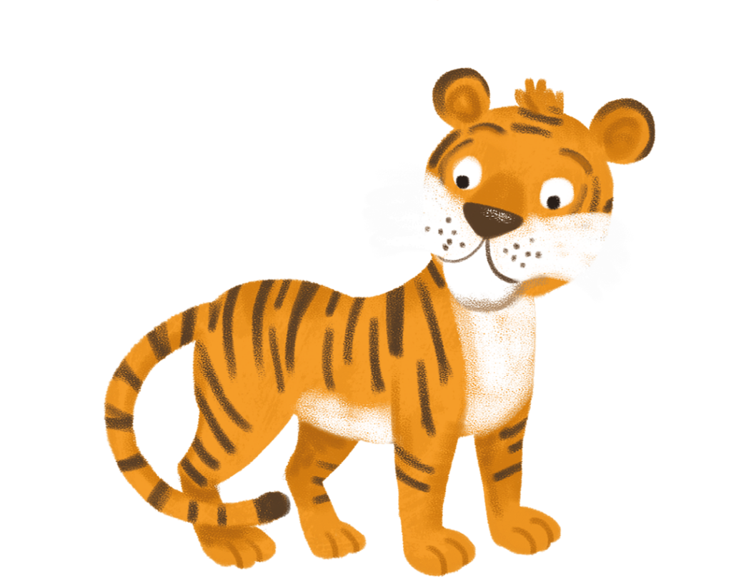
Suas is sìos
Suas is sìos
Aon, dhà, trì
Tìgear buidhe, tìgear buidhe
Leum, leum, uì !
Notes:
Up and down
Up and down
One, two, three
A yellow tiger, a yellow tiger
Jump, jump, weeeeeee!

